Slide 1
An Overview of Collective Impact:
Principles & Perspectives
North Carolina Council on Developmental Disabilities
Thursday, February 8, 2018
Linda Kendall Fields, M.Ed., Clinical Assistant Professor, UNC – Chapel Hill, School of Social Work, Jordan Institute for Families

Slide 2
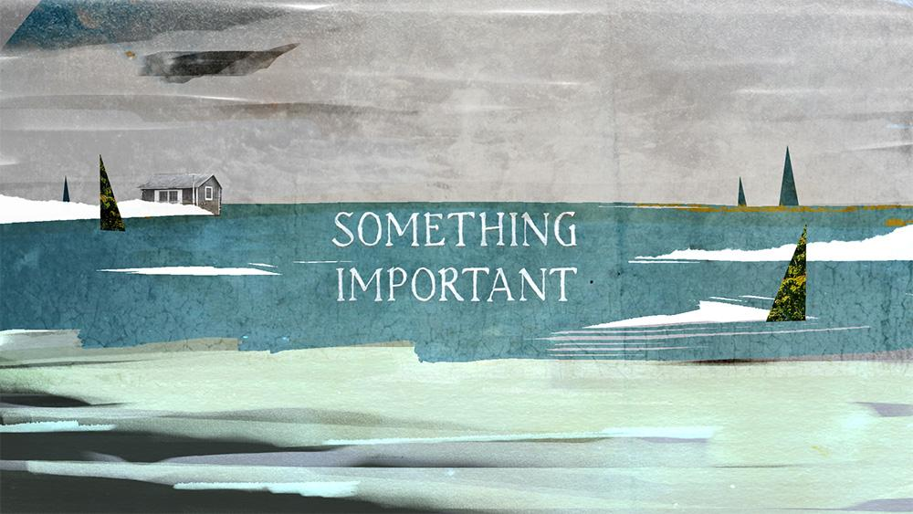
What is important to me? What is important to you?

Slide 3

If you were in charge of solving a complex social problem, how would you do it?

Slide 4
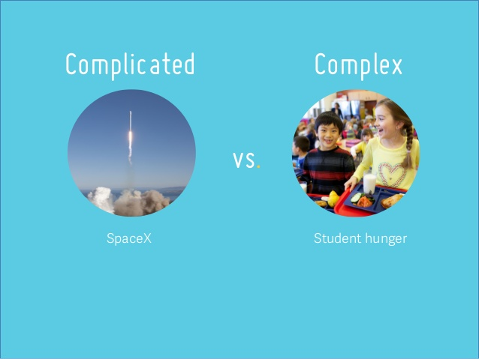

Slide 5
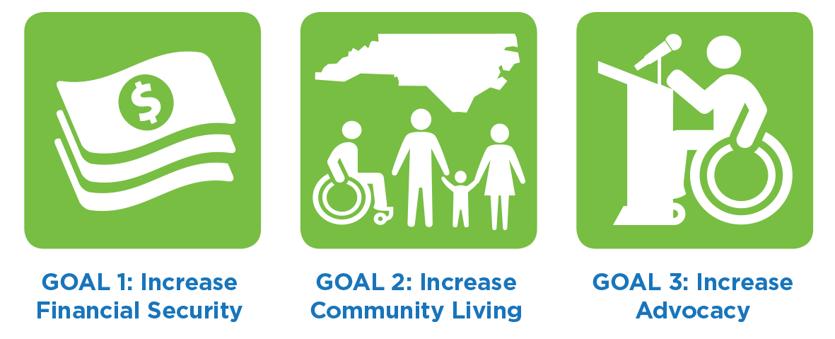
Complicated or Complex?

Slide 6
Collective Impact is…
“the commitment of a group of cross-sector actors to a common agenda for solving a complex social problem”*
* John Kania and Mark Kramer, “Collective Impact,” Stanford Social Innovation Review, Winter 2011

Slide 7
Watch Video
Notes:
Common Agenda:
All participants share a vision for change that includes a common understanding of the problem and a joint approach to solving the problem through agreed-upon actions.
Shared Measurement:
All participating organizations agree on the ways success will be measured and reported, with a short list of common indicators identified and used for learning and improvement.
Mutually Reinforcing Activities:
A diverse set of stakeholders, typically across sectors, coordinate a set of differentiated activities through a mutually reinforcing plan of action.
Continuous Communication:
All players engage in frequent and structured open communication to build trust, assure mutual objectives, and create common motivation.
Backbone Support:
An independent, funded staff dedicated to the initiative provides ongoing support by guiding the initiative’s vision and strategy, supporting aligned activities, establishing shared measurement practices, building public will, advancing policy, and mobilizing resources.

Slide 8
Collective Impact – It takes time!
Common Agenda:
All participants share a vision for change that includes a common understanding of the problem and a joint approach to solving the problem through agreed-upon actions.
Shared Measurement:
All participating organizations agree on the ways success will be measured and reported, with a short list of common indicators identified and used for learning and improvement.
Mutually Reinforcing Activities:
A diverse set of stakeholders, typically across sectors, coordinate a set of differentiated activities through a mutually reinforcing plan of action.
Continuous Communication:
All players engage in frequent and structured open communication to build trust, assure mutual objectives, and create common motivation.
Backbone Support:
An independent, funded staff dedicated to the initiative provides ongoing support by guiding the initiative’s vision and strategy, supporting aligned activities, establishing shared measurement practices, building public will, advancing policy, and mobilizing resources.

Slide 9
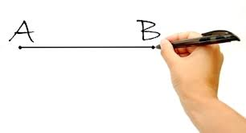
How the change story is told

Slide 10
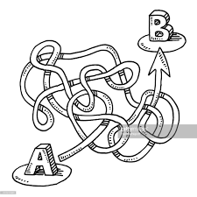
The real story of how change happens

Slide 11
Early Collective Impact – more about questions than answers
What organization/group will be the dedicated “backbone” for the initiative?
Who needs to be at the table – the “usual suspects” and the not-so-usual suspects?
What is known and not known about the issue?
What has been tried? How did it work?
What does success look like from the perspective of the consumer/focus person?
Deepen understanding of the issue(s) through data and stories

Slide 12


Slide 13
Collective Impact In Action…
Common Agenda or “Shared Aspiration,” written in “outcome language” emerges as members of the work group spend time together sharing stories, expertise and insight.
Divide up the work in focused, manageable, mutually reinforcing areas and harness the interest of individuals to operate within their spheres of influence
Shared Measurement may or may not be ready, depending on what data and tools exist. In Collective Impact, move away from “Plan the work; work the plan” to “Act, react, adapt.”

Slide 14
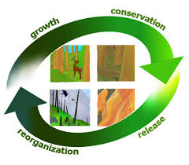
Collective Impact through time:
The Adaptive Cycle

Slide 15
Lessons Learned: Collective Impact
Stay close to the source – those impacted by the issue create energy for the movement.
Provide leadership but keep humility- watch for new ideas and solutions to emerge
Carry the Common Agenda wherever you go – it’s critical to group alignment
Welcome and engage dissenting voices – they can reveal blind spots and sabotage if excluded.
Long and detailed strategic action plans drain energy – keep action plans short & stay responsive to change and emerging ideas
Maintain a commitment to being a learning community and use this to evaluate, grow and change course.
Let go of the need to centralize control – watch (and enjoy) people work within their spheres of influence.

Slide 16

“When you dream alone, it remains just a dream; when you dream together it is the beginning of a new reality.”
~ Brazilian Proverb

Slide 17
THANK YOU!

